Slide 1
Storytelling Case Study: Airbnb, NYC
By: Ashutosh Francis
Tanzeel Iqbal &
Vedant Patil

Slide 2
Agenda:
Objective
History
Data Preparation
Key Insights with Visualisation
Inferences from case study

Slide 3
Objective:
Airbnb is an online platform used by people to rent their unused accommodations.
During the covid pandemic time, Airbnb had incurred a huge loss in the revenue.
Now people have started travelling again and Airbnb want to rise the business again and ready to serve to customers.

Slide 4
History:
For the past few months, Airbnb has seen a major decline in revenue.
Now that the restrictions are reduced and people started travelling more, Airbnb wants to prepare itself for this change.
So an analysis is done on a dataset consisting of various Airbnb listings in New York.

Slide 5
Data Preparation:
Understood the dataset
Cleaned data to remove any missing values and duplicates if present in the dataset.
Dropped columns which are insignificant.
Identified outliers present in the dataset

Slide 6
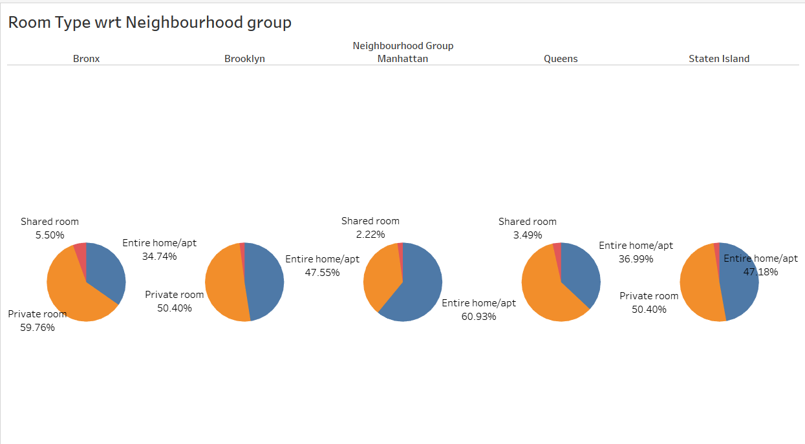
Room type with respect to Neighbourhood group:
Manhattan and Brooklyn are topmost neighbourhood groups and people prefer to book the entire home or private room mostly.
Manhattan has 60.93% home/apt properties, i.e. highest of total listed properties.
Bronx has maximum number of private rooms i.e. around 59.76% of total listed properties.
Very less number of shared rooms are available in each Neighbourhood group.

Slide 7
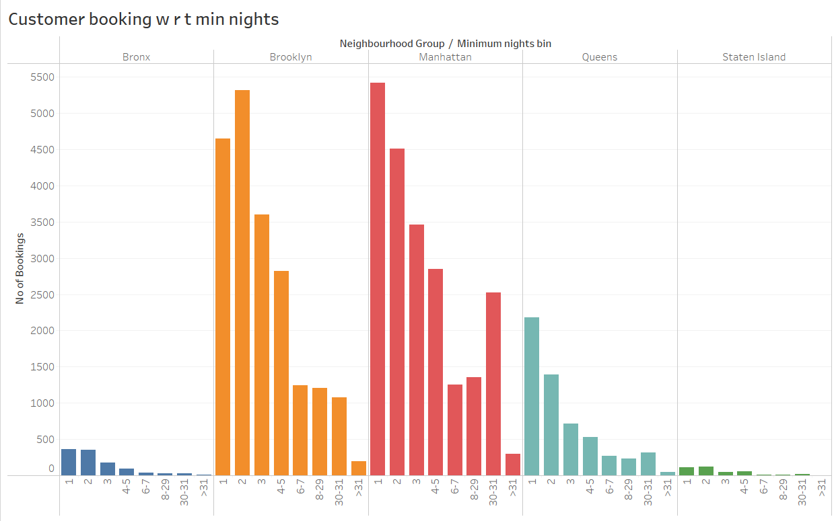
Customer Booking with respect to minimum nights:
Listings with Minimum nights 1-5 have the most number of bookings. A good spike can be seen in 30 days, this will be because customers would rent out on a monthly basis.
We can also see small spikes after 30 days, this can also be observed by the monthly rent taking trend.
Manhattan & Queens have larger number of 30 day bookings compared to the others. The reason can be either long stay bookings of tourists or mid-level employees who opt for budget bookings due company visits.

Slide 8
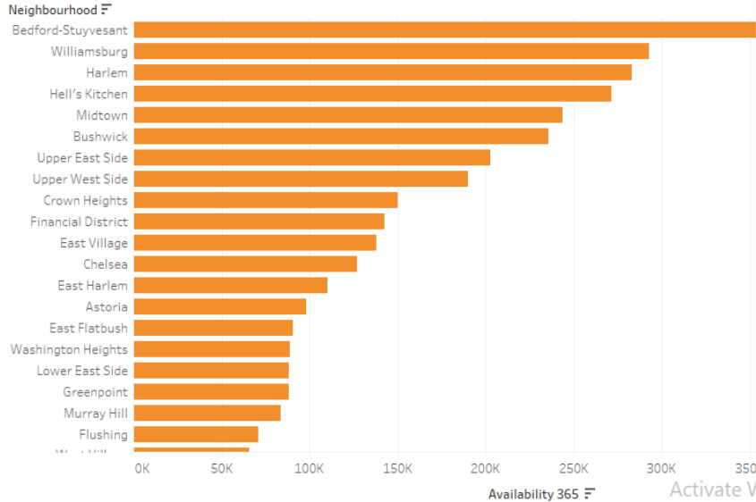
Neighbourhood Vs Availability:
Availability of Bedford is highest and also its price is lower. It is definitely a good choice for customers.
We can see that after Bedford, Harlem follows the trend.
Chelsea’s availability is low but it is costlier.
On the other hand, William’s has average availability but price is high.

Slide 9
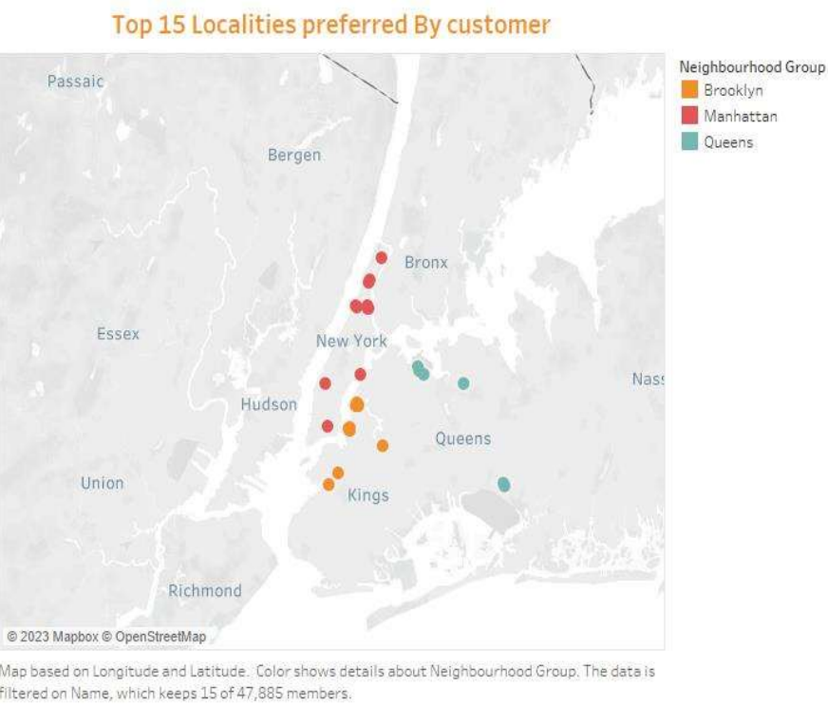
Locality:
Top 15 location where people preferred to stay more
We can see that most of them are in Manhatten

Slide 10
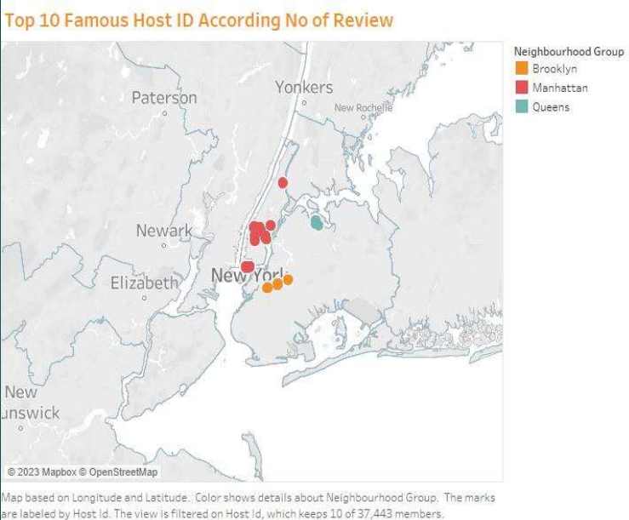
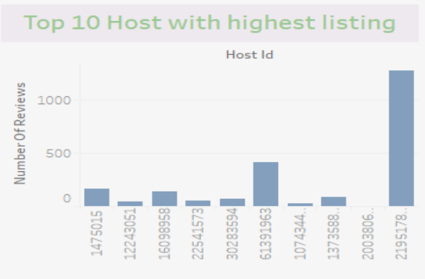
Majority of the popular host are in manhatten , to get traction for unpopular properties.
Head of acquisition and Opertions can talk with this host and negotiate with them.

Slide 11
Inferences from the case study:
We have observed that people like to visit the center of New York, where the beauty of the city can be seen.
The Entire Room or apartment is most listed room type & customers prefers it mostly , while exactly opposite is true for shared room.
Manhattan & brooklyn are costliest neighborhood group, but still customers prefer them.
We can focus on the locations that are present in Manhatten and Brooklyn because these are most famous prime locations as people shows interest in it.
We have observed that people show interest in the host blueground and also spend more nights there.
Management cant talk with famous host who listed there property in Manhatten & Brooklyn to increase attraction for unpopular properties.

Slide 12
Thank You

